Slide 1

GUJARAT TECHNOLOGICAL UNIVERSITY
SCHOOL OF ENGINEERING AND TECHNOLOGY
Post Graduate Diploma
in
Data Science
(Institute Code: 137)
Mini Project
(DS02080041)
Gold Price Prediction
Review-1
Sangita Shivprakash Gurudatta
251370680003
Internal Guide: Prof.Mahesh Panchal
Designation:

Slide 2
Index
Introduction
Need of the Project
Problem Statement
Objectives
Methodology
Tools and Technologies
Expected Outcome
Scope of the Project
Conclusion
References

Slide 3
Introduction
Gold is one of the most trusted investment options in the world. Its price keeps changing due to many factors like currency value, inflation, and global market conditions. Because of this constant fluctuation, predicting gold prices is not easy.
In this project, I try to analyze past gold price data and use machine learning techniques to predict future prices. The aim is to build a smart and reliable prediction system.

Slide 4
Need of the Project
Gold price prediction is useful for:
Investors Traders
Financial analysts
Banks
Traditional methods are not always accurate because financial data is complex.
So, machine learning models are used to improve prediction accuracy.

Slide 5
Problem Statement
Gold prices change frequently and depend on many economic factors. It is difficult to predict future prices using simple mathematical formulas.
Therefore, this project aims to develop a machine learning model that can analyze past trends and predict future gold price movements with better accuracy.

Slide 6
Objectives
To collect and study historical gold price data.
To analyze trends and patterns in the data.
To apply machine learning algorithms for prediction.
To compare different models and find the best one.
To measure performance using R² and error values.

Slide 7
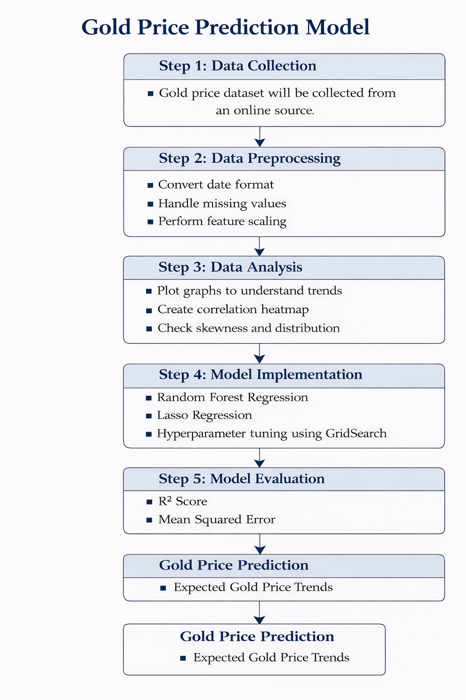
Methodology

Slide 8
Dataset Overview
Source: https://raw.githubusercontent.com/sangitaGIT011/Myproj/refs/heads/main/gold_price_data.csv
Time Period: 2008–2018
Data Type: Time-Series Financial Data
Features | Description | Data Type
Date | Trading Date | Date
GLD | Gold ETF price | Float
SLV | Silver ETF price | Float
SPX | S&P 500 index value | Float
USO | Oil ETF price | Float
EUR/USD | Exchange rate | Float

Slide 9
Tools and Technologies
Python
NumPy
Pandas
Seaborn & Matplotlib
Scikit-learn
XGBoost

Slide 10
Expected Outcome
A working prediction model
Better understanding of gold price behavior
Identification of important influencing factors
Improved prediction accuracy

Slide 11
Scope of the Project
This project can be extended in the future by:
Real-time API-based data ingestion
Sentiment analysis incorporation
Multi-currency forecasting expansion
Deployment as financial decision-support dashboard

Slide 12
Conclusion
This project aims to build a smart system for predicting gold prices using machine learning techniques. By analyzing past data and trends, the model will try to give better and more reliable predictions.

Slide 13
References
NumPy Documentation. Available at: https://numpy.org
Pandas User Guide. Available at: https://pandas.pydata.org
Machine Learning in Python Documentation. Available at: https://scikit-learn.org
Matplotlib Documentation. Available at: https://matplotlib.org
Seaborn Statistical Visualization Guide.
Gold Price Dataset. Retrieved from GitHub Repository: https://github.com/sangitaGIT011/Myproj

Slide 14
THANK YOU

